Slide 1
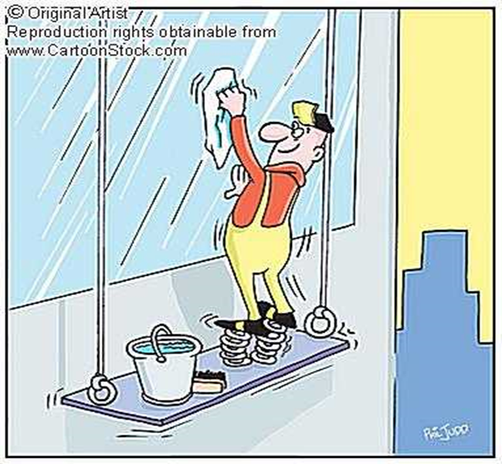


DOWNLOAD HSE DOCS FROM HSEPROF.COM
www.hseprof.com
Working at Heights
HSE Presentation

Slide 2
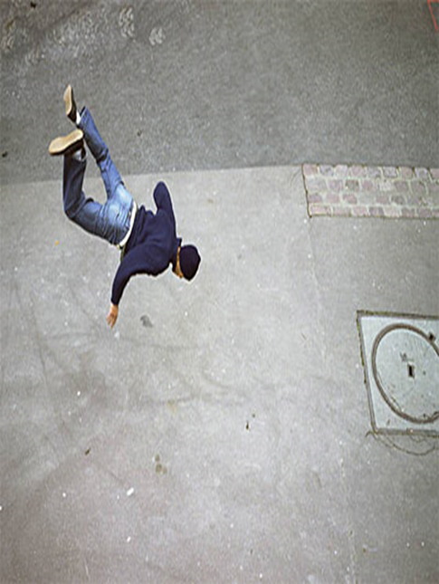
DOWNLOAD HSE DOCS FROM HSEPROF.COM
Falls in Construction
  Falls are the leading cause of death in the construction industry.
  Most fatalities occur when employees fall from open-sided floors and through floor openings.
  Falls from as little as 1.2 to 1.8 meters can cause serious lost-time accidents and sometimes death.
www.hseprof.com

Slide 3
DOWNLOAD HSE DOCS FROM HSEPROF.COM
Definition
  Working at Height means:
  Working on temporary or permanent structures that are greater than 1.8 meters above the ground or floor level
  Some potential hazards for those involved due to the height above grade whilst it also carries a potential risk for those directly below the work site.
www.hseprof.com

Slide 4
Causes of Falling from Height
DOWNLOAD HSE DOCS FROM HSEPROF.COM
  Engineering factors – missing guardrails and safety harnesses, unreliable or unstable scaffoldings, floors, ladders;
  Process factors – mistakes in method statements or operation procedures;
  Psychological factors – fear, coordination impairment, careless moves, unsafe behavior;
  Weather factors – strong wind, extremely hot or cold temperature, rain, snow, fog, ice.
www.hseprof.com

Slide 5
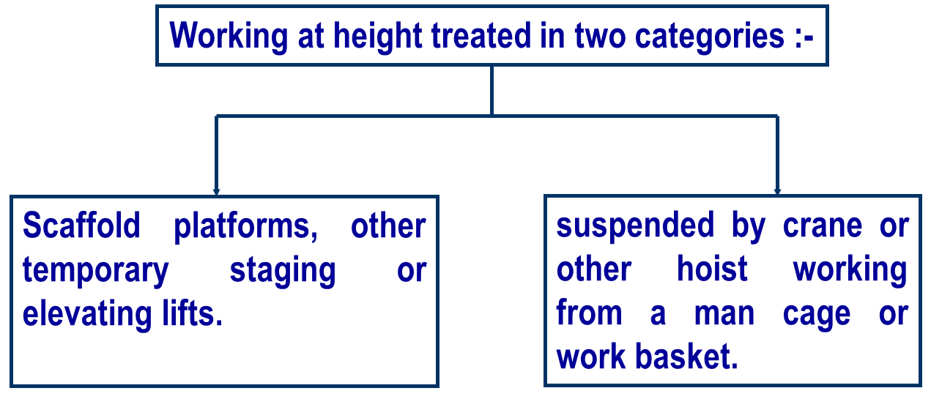
Working at Height
DOWNLOAD HSE DOCS FROM HSEPROF.COM
www.hseprof.com

Slide 6
Working at Height
DOWNLOAD HSE DOCS FROM HSEPROF.COM
  Personnel should have suitable PPE, information, instruction, training, and supervision.
  Suitable and effective measures must be taken to prevent any person falling from a distance likely to cause injury.
  Suitable and effective measures must be taken to prevent them being struck by falling objects likely to cause injury.
  Areas of risk exist proper warning signs must be posted.
  far as practicable every tank, pit, structure and traffic route over or crossed must be securely covered and fenced.
www.hseprof.com

Slide 7
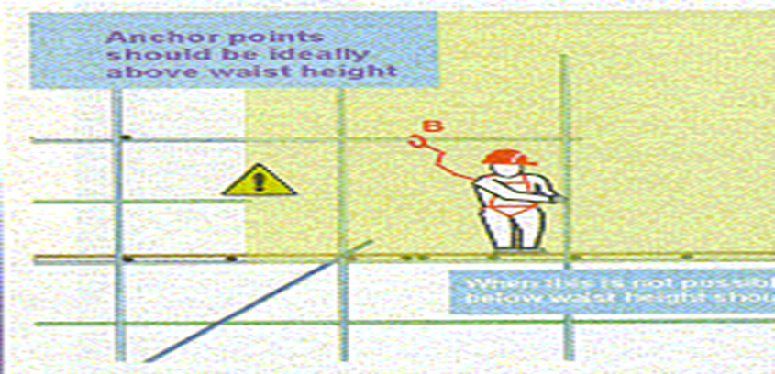
Working at Height
Working on scaffolding
DOWNLOAD HSE DOCS FROM HSEPROF.COM

Slide 8
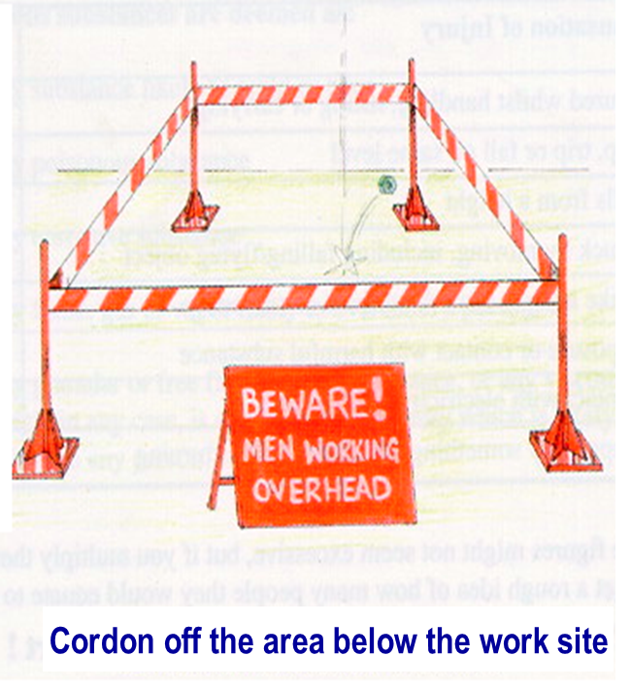
Signs and Barricade
DOWNLOAD HSE DOCS FROM HSEPROF.COM
  Working in height excess of 2 meters above the ground or deck ( or over the side ) special precautions must be taken to ensure the personnel safety.
  Protection of anyone who may be below the work site.
  Cordon off the area below - to prevent personnel injury or anything drop.

Slide 9
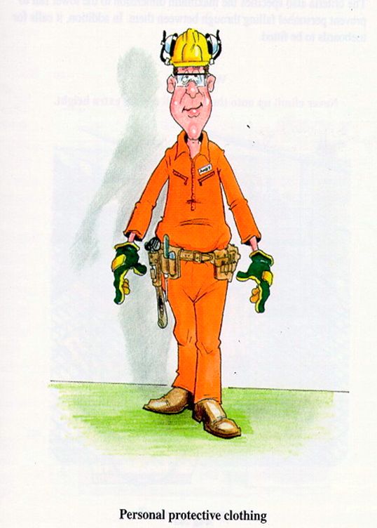
www.hseprof.com
Personal Protective Equipment
DOWNLOAD HSE DOCS FROM HSEPROF.COM
  Personnel Protective Equipment:
  Appropriate personnel equipment must be used such as safety helmet, toe cap boot or shoes, coverall, safety harness etc.
  Make sure that the clothing must be neat fitting.
  Use the chin strap of the helmet

Slide 10
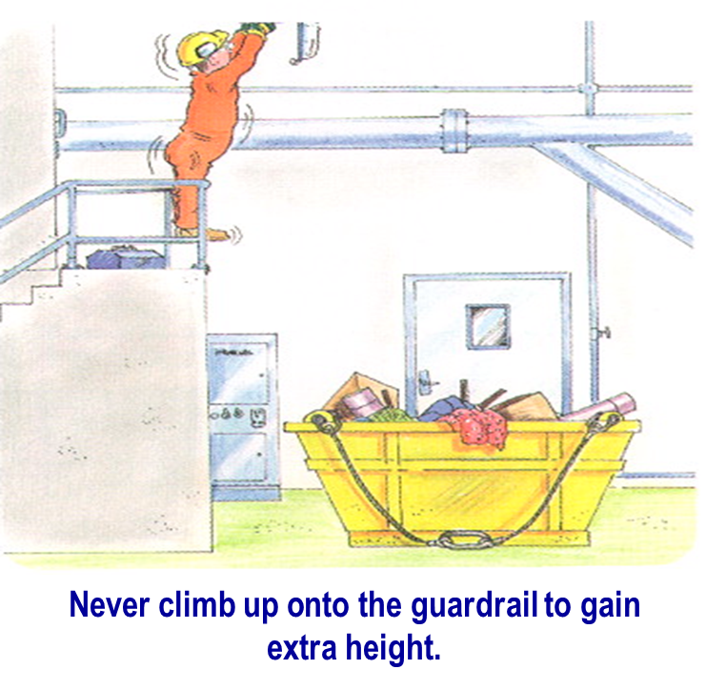
Falling from Heights
DOWNLOAD HSE DOCS FROM HSEPROF.COM
Guardrail:
  The minimum height of the top rail above floor level should be 1100mm. This ensures the average person’s center of gravity.
www.hseprof.com

Slide 11
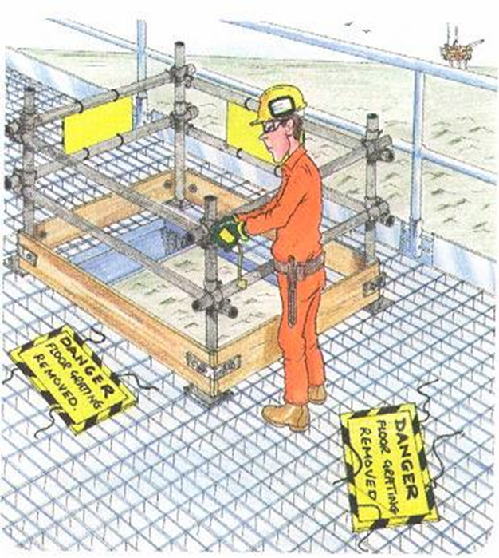
Guardrail
DOWNLOAD HSE DOCS FROM HSEPROF.COM
Temporary guardrail:
  For maintenance or access purpose a fencing may be required to remove. A temporary guard rail is required to erect around the area . e.g. removing deck gratings, floor boards.
  Ensure that the temporary guardrails also must meet the safety standards
www.hseprof.com

Slide 12
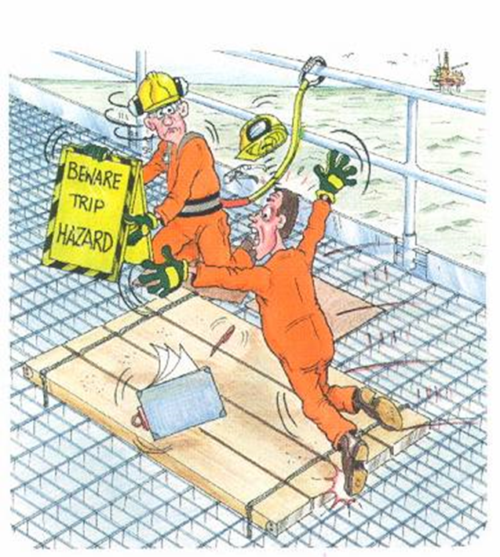
Temporary Flooring
DOWNLOAD HSE DOCS FROM HSEPROF.COM
Temporary flooring:
  To make hole safe it can be covered by steel plates or wooden planks to get suitable strength and support.
  The fixed support must not be easily removable.
  TRIP HAZARD signboard must be posted.
www.hseprof.com

Slide 13
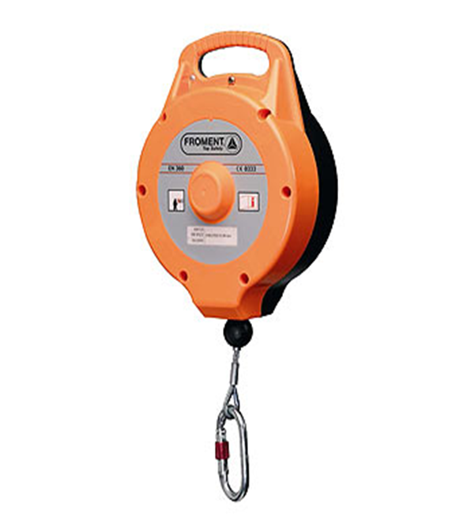
Fall Protection
DOWNLOAD HSE DOCS FROM HSEPROF.COM
Fall arresters:
  The place where the temporary guard rails cannot be erected, use safety harness or fall arresters.
  Before use the equipment inspect thoroughly.
  Make sure that the fall arrester is not shock loaded.
  arrester of the safety line must anchored on a suitable point.
www.hseprof.com

Slide 14
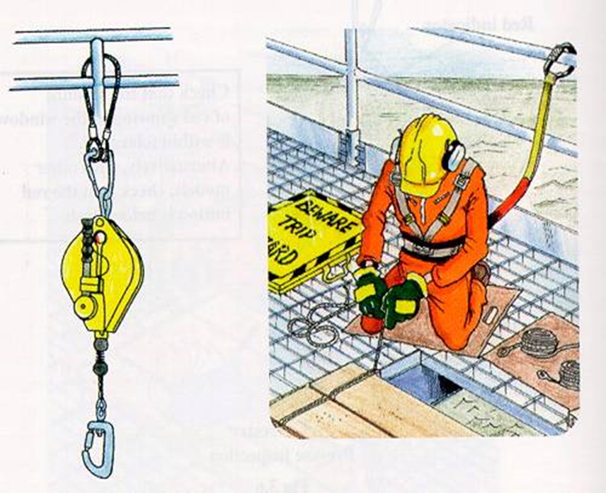
Fall Protection
DOWNLOAD HSE DOCS FROM HSEPROF.COM
Fall arresters:
  The harness must be worn correctly and the safety line must not become trip hazard.
  Suitable anchor points shall be used
www.hseprof.com

Slide 15
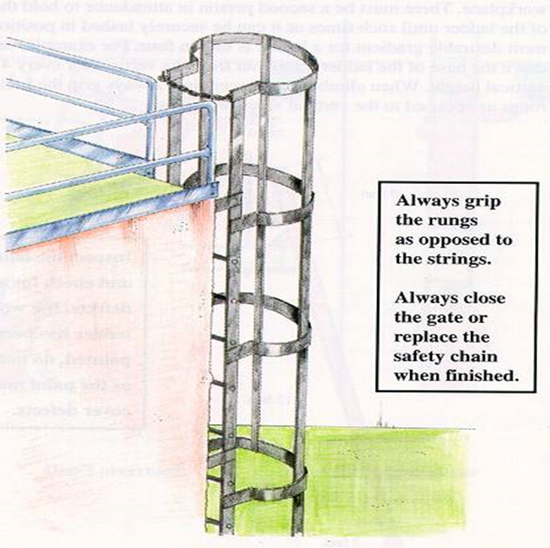
Ladder Cage
DOWNLOAD HSE DOCS FROM HSEPROF.COM
Ladder cage:
  Always grip the rungs as opposed to the strings
  Always close the gate or replace the safety chain when finished.
www.hseprof.com

Slide 16
Use of Ladder
DOWNLOAD HSE DOCS FROM HSEPROF.COM
Use of portable ladders:
  Choose the correct ladder according to the nature of work.
  Wooden ladder to be used when working with any electrical apparatus or electrical supply.
  The ladder height must be extended 1m above workplace.
  The second person must support the ladder until it is properly secured.
  When climbing or descending always grip the horizontal rungs.
  Never try to overreach, come down and reposition the ladder closer to the work site.
www.hseprof.com

Slide 17
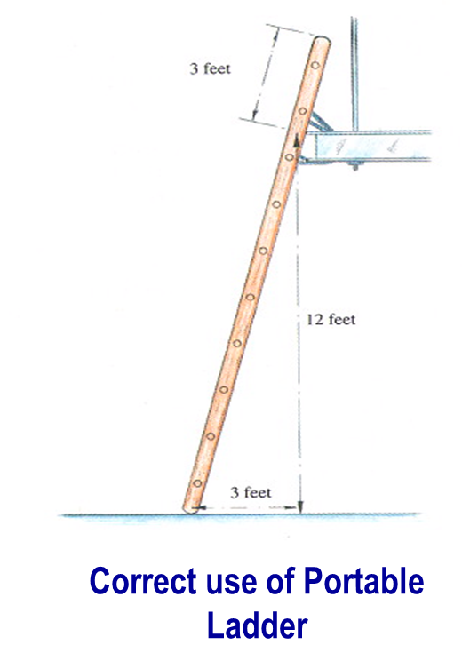
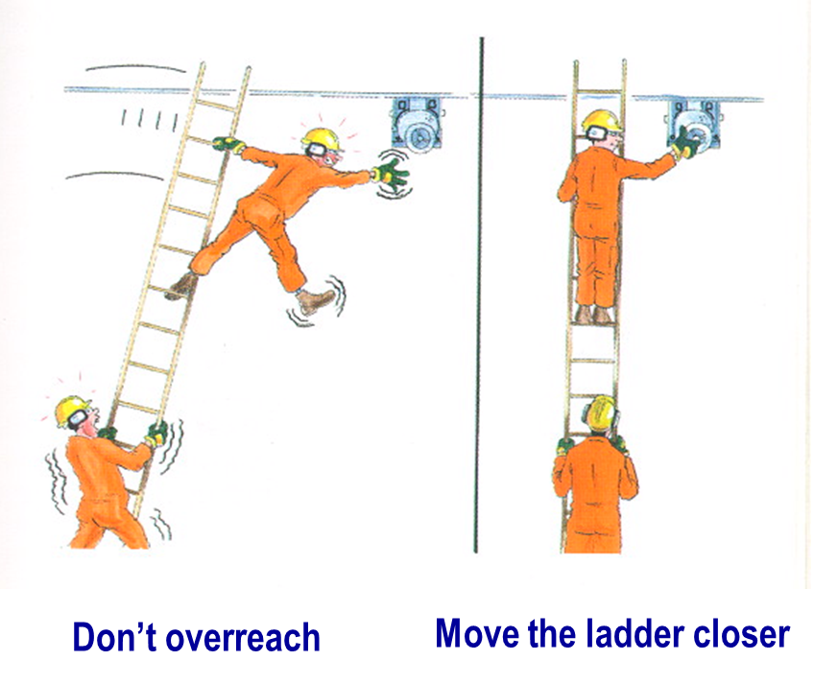
Use of Ladder
DOWNLOAD HSE DOCS FROM HSEPROF.COM
www.hseprof.com

Slide 18
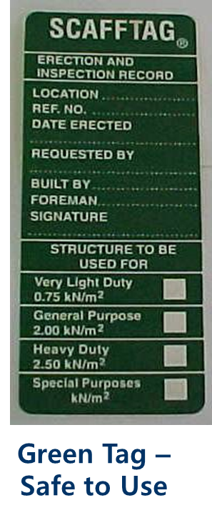
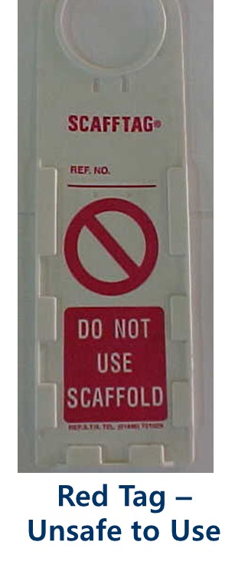
Scaffolding Tag
DOWNLOAD HSE DOCS FROM HSEPROF.COM
Scaffolding Access:
  Never use an incomplete or uncertified scaffold.
  Never make unauthorized alterations.
  Never climb up on the guard/handrails to gain extra height.
  Never drop or throw things down from scaffolding.
www.hseprof.com

Slide 19
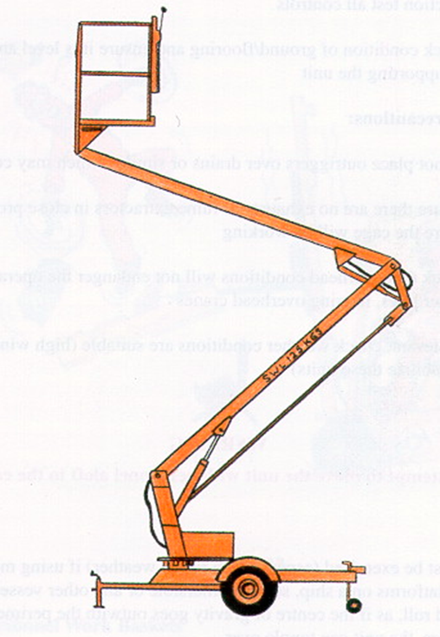
Mobile Working Platform
DOWNLOAD HSE DOCS FROM HSEPROF.COM
Mobile working platforms:
  Do not place outriggers over drains or similar which may collapse.
  Ensure there are no exhausts or fume extractors in close proximity to where the cage will be working.
  Check that overhead conditions will not endanger the operator.
  Check whether weather conditions are suitable.
  Never attempt to move the unit with the personnel aloft in the cage.
www.hseprof.com

Slide 20
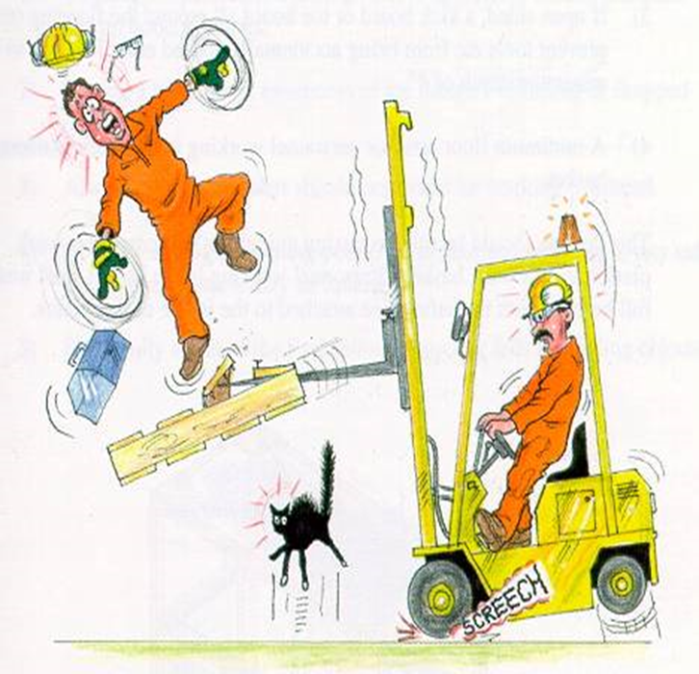
Mobile Working Platform
DOWNLOAD HSE DOCS FROM HSEPROF.COM
Makeshift platforms:
  Never use a makeshift work platform to reach a height.
www.hseprof.com

Slide 21
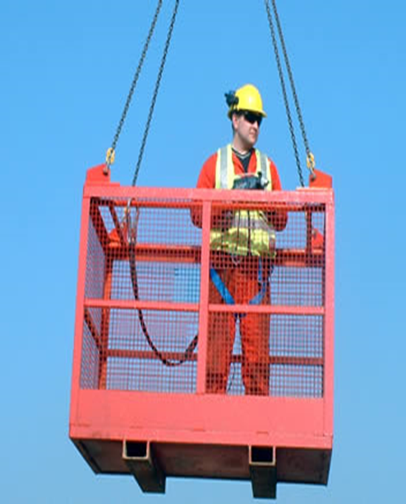
Personnel Man basket
DOWNLOAD HSE DOCS FROM HSEPROF.COM
Personnel Man basket
  A minimum height from the floor of the platform to the top handrail to prevent them from toppling over or falling out.
  If open sided a maximum vertical distance between the handrail and immediate rail to prevent falling through between them
  If open-sided a kickboard or toe board to be provided.
  Personnel working in the basket shall wear full-body harnesses with safety lines attached to the basket or to the hook block or headache ball.
www.hseprof.com

Slide 22
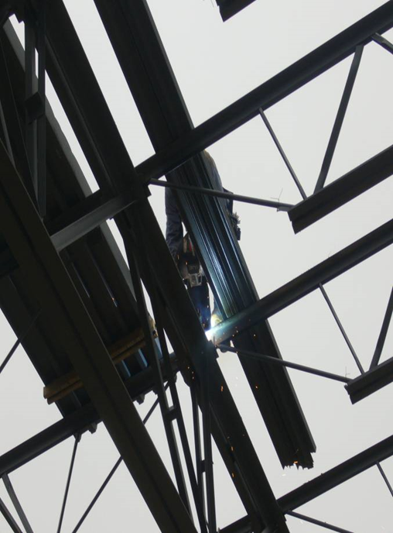
Falling Object
DOWNLOAD HSE DOCS FROM HSEPROF.COM
  Securing tools and materials
  materials must be removed or secured at the end of the work.
  attention is required on round or cylindrical equipment.
  and hot slag needs to be contained.
  materials are to be used to protect the job done below.
www.hseprof.com

Slide 23
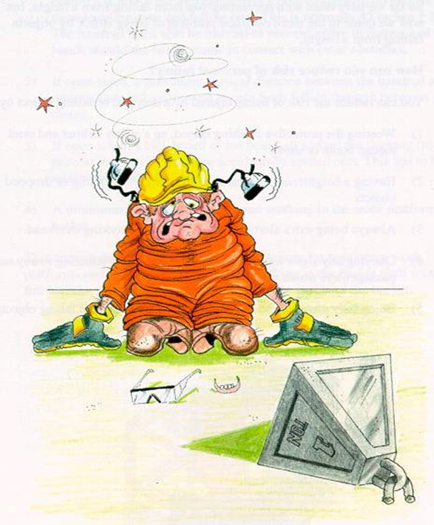
Falling Object
DOWNLOAD HSE DOCS FROM HSEPROF.COM
Falling objects:
  Reduce the risk of personnel injury by:
> Wear appropriate PPE.
> Should have awareness of the dangers of falling or dropped objects.
> Always be extra alert should personnel work overhead.
> Obey any signs and warnings.
www.hseprof.com

Slide 24
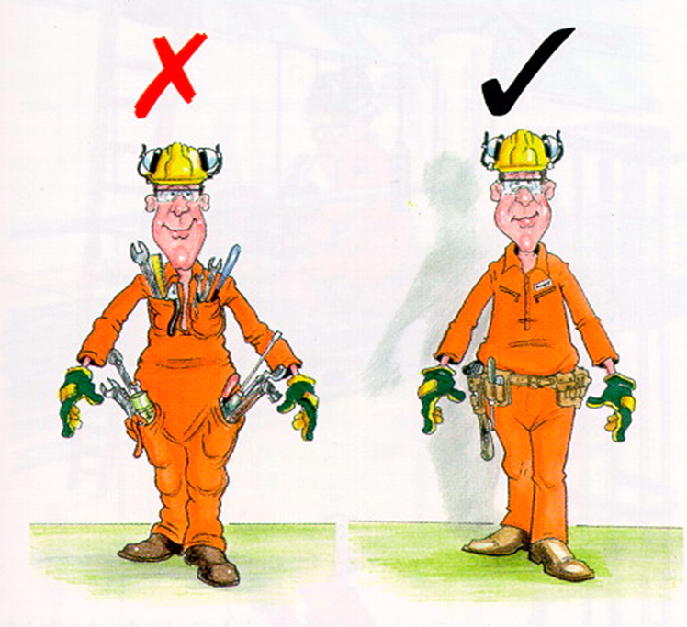
Falling Object
DOWNLOAD HSE DOCS FROM HSEPROF.COM
Carrying tools
  Never secure the tools in the pocket.
  Always use a properly designed tool belt.
  Try to secure the tool with a thin rope to avoid trip hazards.
www.hseprof.com

Slide 25
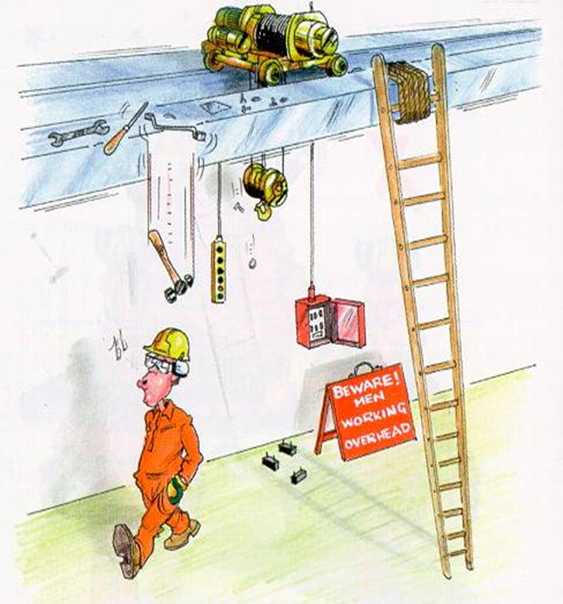
Falling Object
DOWNLOAD HSE DOCS FROM HSEPROF.COM
Unsecured tools or machine parts:
  leaving the tools purposely without securing can fall due to wind, vibration, sudden movement or hosing down for cleaning purposes.
www.hseprof.com

Slide 26
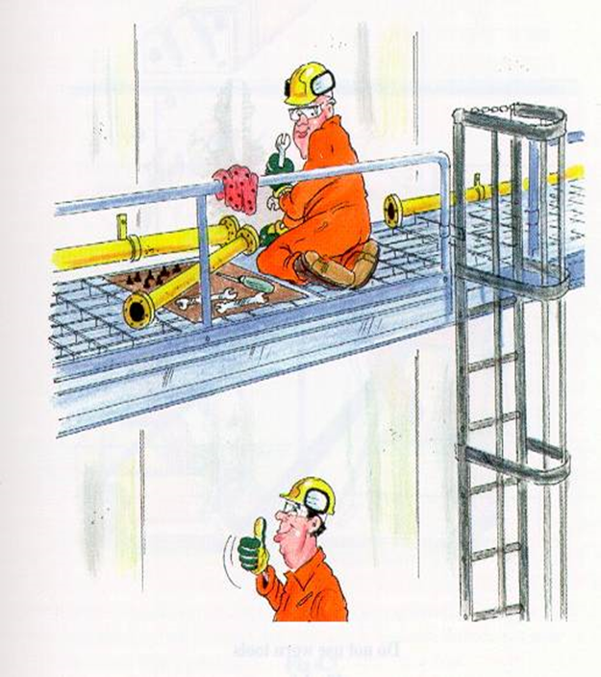
Falling Object
DOWNLOAD HSE DOCS FROM HSEPROF.COM
Small Tools and Parts:
  Placing small hand tools or machine parts on open grating floors can cause it to fall down
  Provide a proper toolbox or floor support or blanket to prevent small materials from rolling and falling
www.hseprof.com

Slide 27
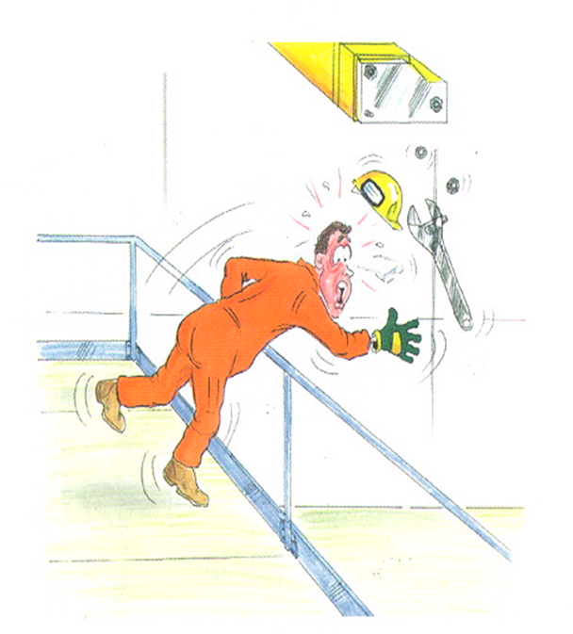
Falling Object
DOWNLOAD HSE DOCS FROM HSEPROF.COM
Using hand tools at height:
  Excessive force will cause the spanner slipping off a nut and will lead the tools to fall down
  Defective hand tools can also cause it to slip and fall down
  Hand tools shall be secured with a small rope attached to the wrist to prevent it from accidentally falling
www.hseprof.com

Slide 28
Checklist
DOWNLOAD HSE DOCS FROM HSEPROF.COM
  Are practical control measures in place to eliminate or reduce the risk of falling?
> Have you identified potential or existing hazards and assessed the risks of anyone falling from heights?
> Have you considered alternative ways of carrying out the work?
> Have you assessed whether a fall would be broken before hitting the ground/other structure?
www.hseprof.com

Slide 29
Checklist
DOWNLOAD HSE DOCS FROM HSEPROF.COM
  Is there safe access and egress to work being performed at heights?
Have you checked the stairs?
Have you checked the walkways?
Have you checked the ladders?
Have you checked mechanical lifts?
Are work areas free of obstructions?
www.hseprof.com

Slide 30
Checklist
DOWNLOAD HSE DOCS FROM HSEPROF.COM
Have people working at heights been given adequate information, instruction and training?
> Have you been vigilant in ensuring that safe work practices are in place?
> Have you taken all practical steps to prevent falls?
> Have you got fall prevention systems in place?
> Have you considered alternative ways to do the work?
www.hseprof.com

Slide 31
SUMMARY OF THE HSE PRESETATION
Reducing accidents in the workplace is a sound management practice. Not only it will make your workforce happier, but will also save your money through improved output and will reduce the risk of fines and compensation claims.
DOWNLOAD HSE DOCS FROM HSEPROF.COM
www.hseprof.com

Slide 32

DOWNLOAD HSE DOCS FROM HSEPROF.COM
REPOST
WITH YOUR NETWORK!
www.hseprof.com

